Slide 1
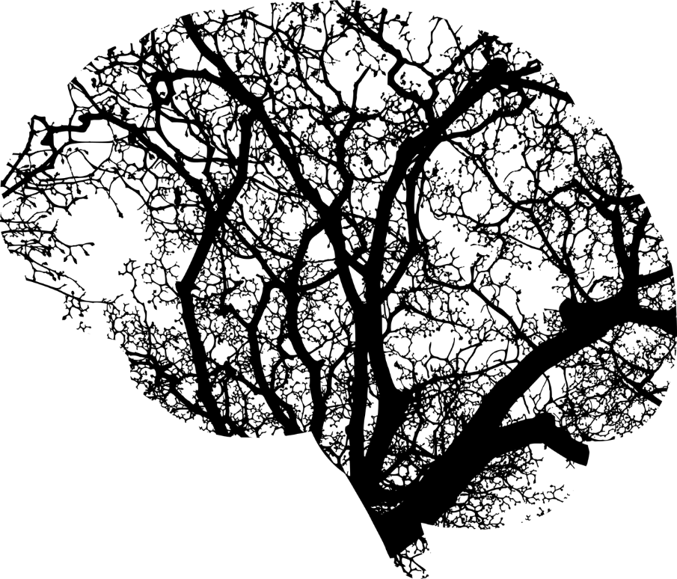


Deep Learning in Medical Image Analysis: A comparative analysis of multi-modal brain-MRI segmentation with 3D deep neural networks
MSc in Biomedical Engineering 2017-2019 Supervisor: Evangelos Dermatas | Student: Adaloglou M. Nikolaos | 1004130

Slide 2
Contents
Magnetic resonance imaging
Machine & Deep learning
Common DNN Architectures for 3D segmentation
Multi-modal brain MRI Datasets
Experimental evaluation
Experimental results
Conclusion & Future Work

Slide 3
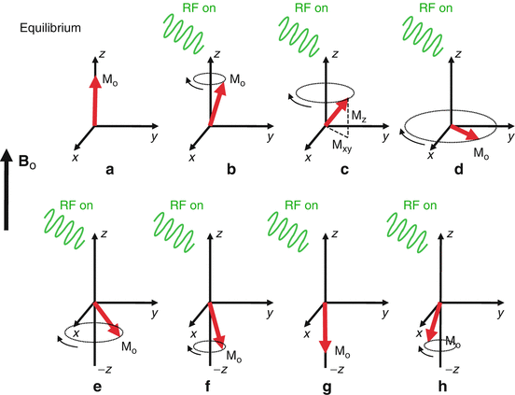
Magnetic resonance imaging
MR signal rapidly fades due to two independent processes:
T1 relaxation: received MR signal slowly fades due to the nuclei dissipation, excessing energy to their surroundings.
T2 relaxation: the individual magnetization vectors begin to cancel each other out instead of adding together, due to loss of phase coherence.

Slide 4
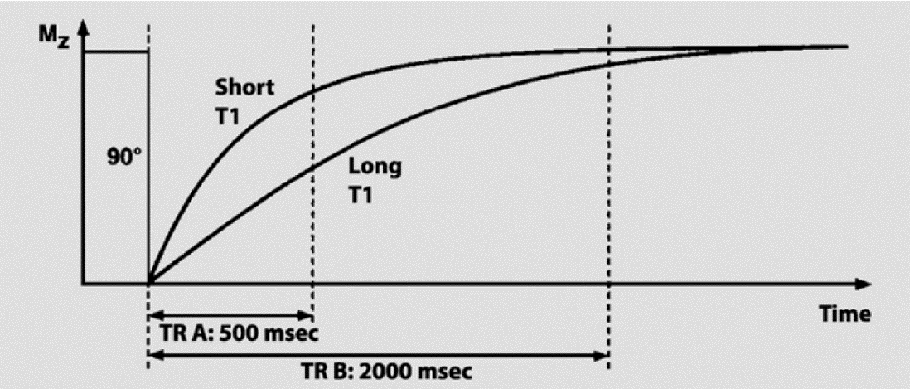
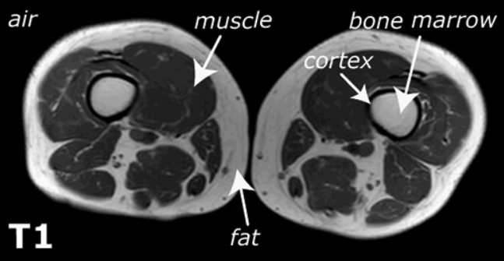
Magnetic resonance imaging
The T1 time of a tissue is the time it takes the excited spins to recover and be available for the next excitation.
The T2 time mostly determines how quickly an MR signal fades after excitation.
Images with contrast that is mainly determined by T1,T2 are called T1, T2-weighted images accordingly

Slide 5
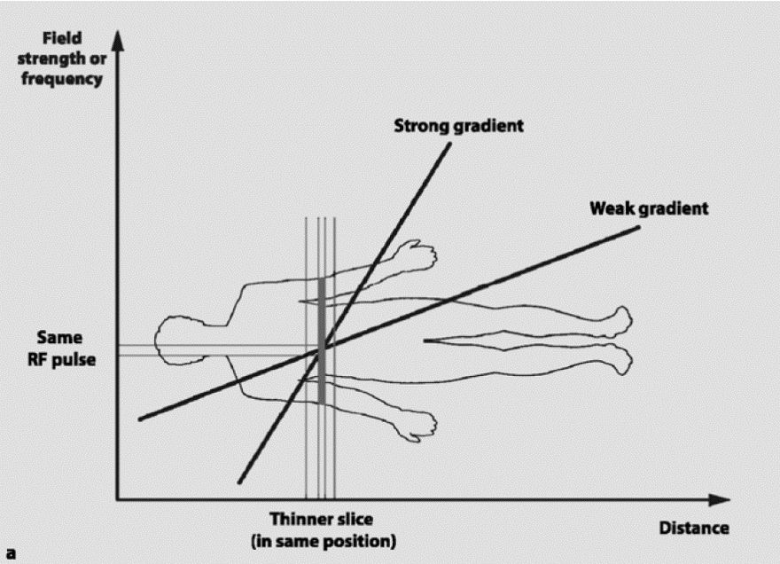
Slice selection
The magnetic field is made inhomogeneous in a linear fashion by means of a gradient coil.
application of an RF pulse that matches the Larmor frequency of the desired slice will excite only protons within the chosen slice while the rest of the body remains unaffected

Slide 6
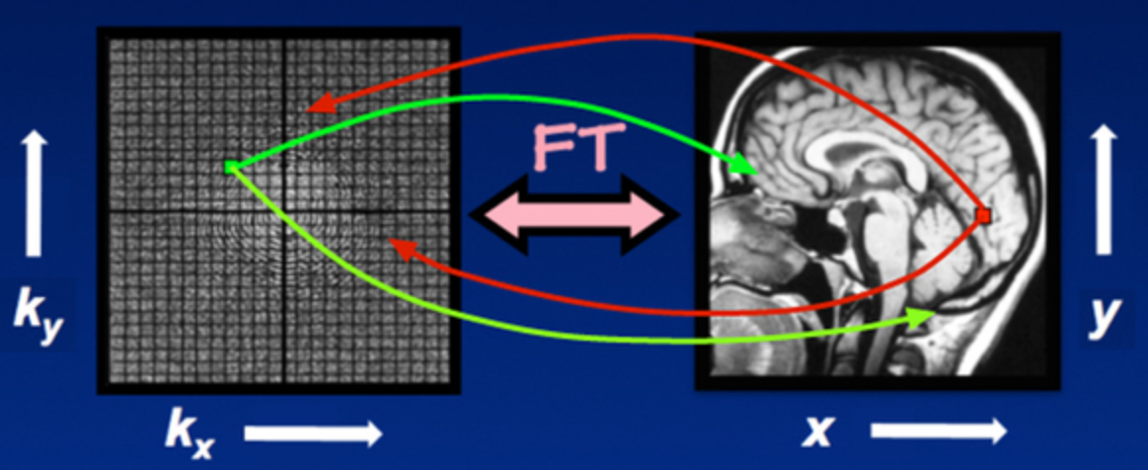
K-space (Fourier space)
Represents the spatial frequency information of an object
Central regions of the k space encode contrast information and peripheral regions of the k space encode spatial resolution
Each pixel in the resultant image is the weighted sum of all the individual points in the k-space.

Slide 7
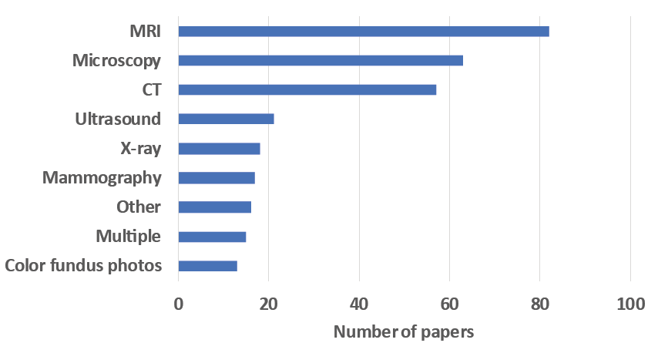
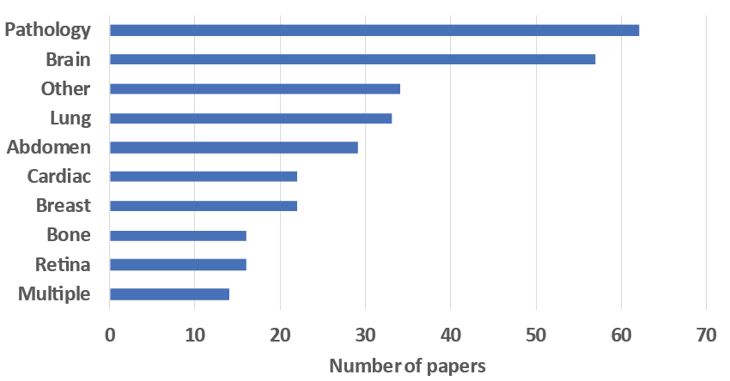
Why Machine/Deep Learning in Medical Imaging?
Healthcare providers generate and capture enormous amounts of data containing extremely valuable signals.
Period: 2015-2017
Source: Litjens, G., Kooi, T., Bejnordi, B. E., Setio, A. A. A., Ciompi, F., Ghafoorian, C. I. (2017). A survey on deep learning in medical image analysis. Medical image analysis, 42, 60-88.

Slide 8
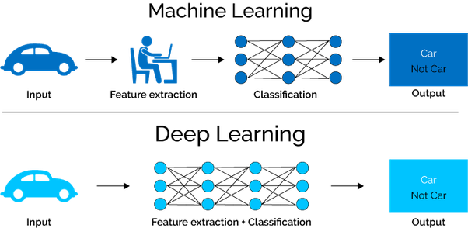
What is Machine Learning and Deep Learning?
Deep learning is a subset of Machine Learning that aims to learn representations of data.
Data representation is learnt as a sequential hierarchy of concepts, with each concept defined in relation to simpler concepts.
More abstract representations computed in terms of less abstract ones.
Simple concepts
Abstract concepts

Slide 9
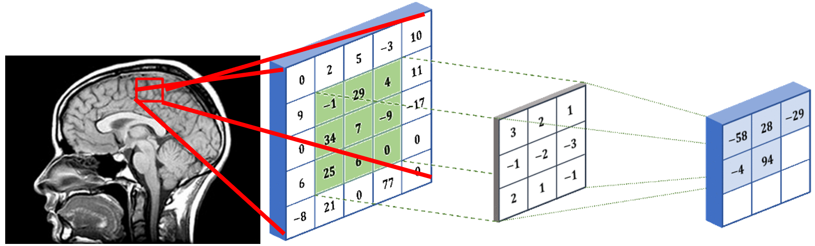
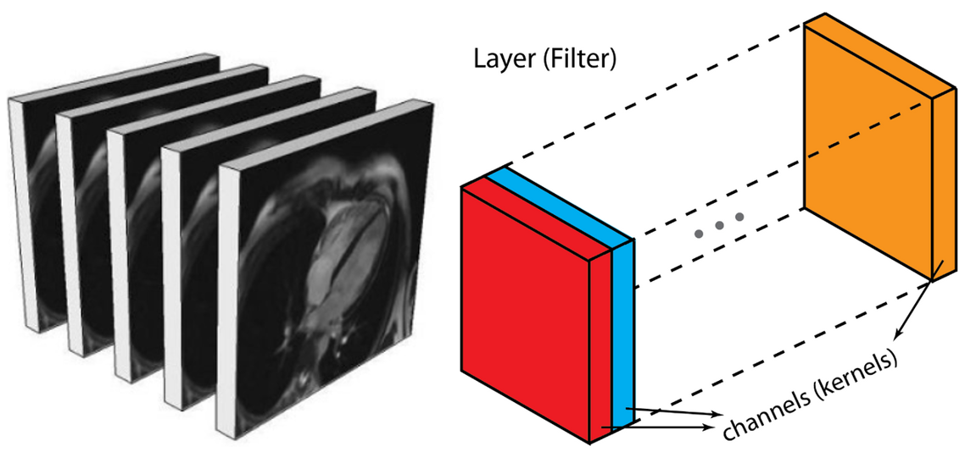
2D Convolutions
A convolutional layer usually consists of multiple channels
Each channel describes different aspects of the previous layer
Transitions between multi channels layers with different depths are made

Slide 10
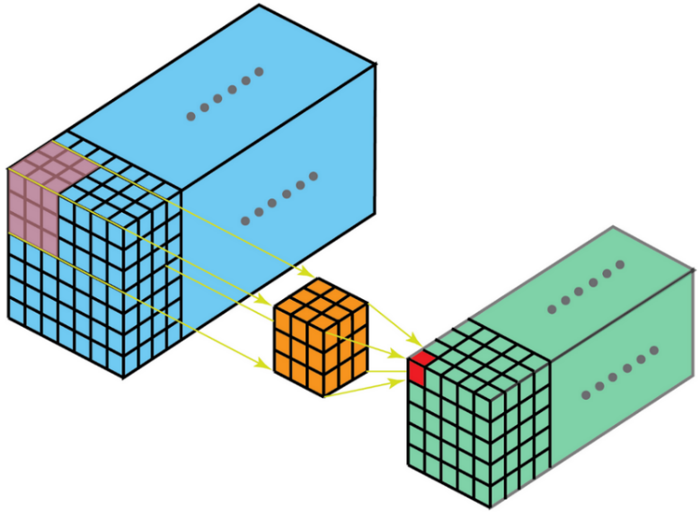
3D convolutions
Filters are slided in the 3D image grid
Correlations are captured across all spatial dimensions
Filter parameters are shared

Slide 11
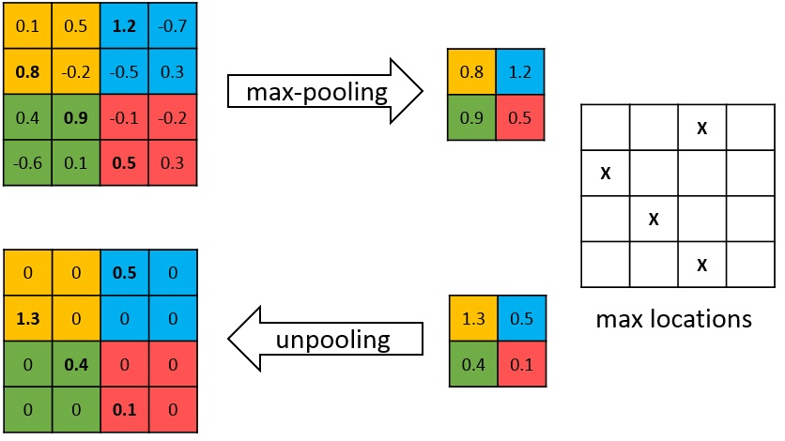
Pooling and Unpooling Layer
Invariance to input
Makes representations more abstract
Pooling operation reduces spatial dimensions

Slide 12
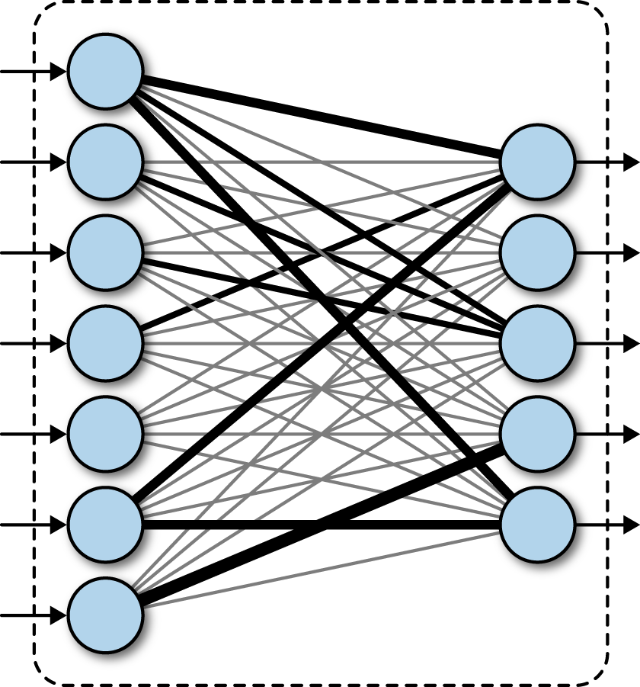
Fully connected layers
Fully connected layers are multiple trainable linear combination of an input (feature) vector’s elements
Linear operator
Can be represented as a matrix multiplication, (fast!)
x1
x2
y1
x3
y2
x4
y3
x5
y4
x6
y5
x7

Slide 13
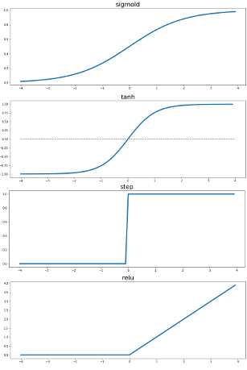
Non-linear activations
Convolution is a linear operator
Activations introduce non-linearities that enable the model to learn more complex representations
Activation functions are generally simple and applied element wise

Slide 14
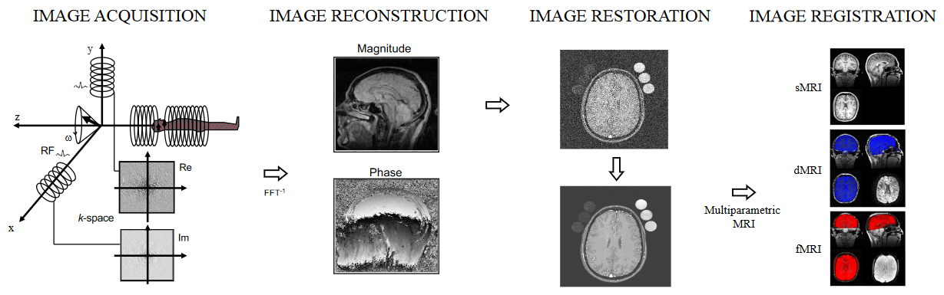
Deep Learning & MRI
Deep Learning is about learning representations/mappings
It can be applied to many stages of MR Image generation, included but not limited to processing of the 3D reconstructed images

Slide 15
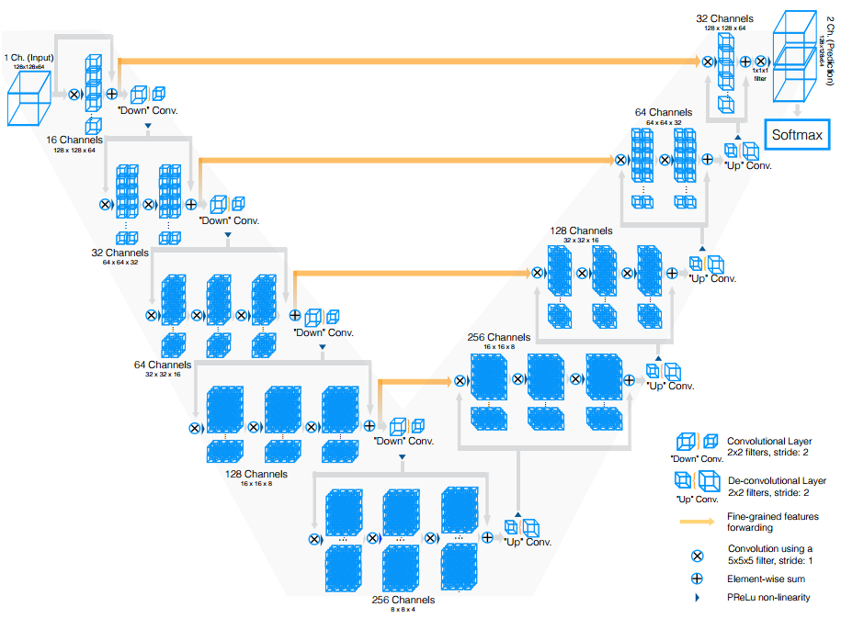
Common DNN Architectures for 3D segmentation - VNET
One of the first works that used volumetric (3D) convolutions instead of slice-wise 2D convolutions.
Data augmentation by applying random non-linear transformations

Slide 16
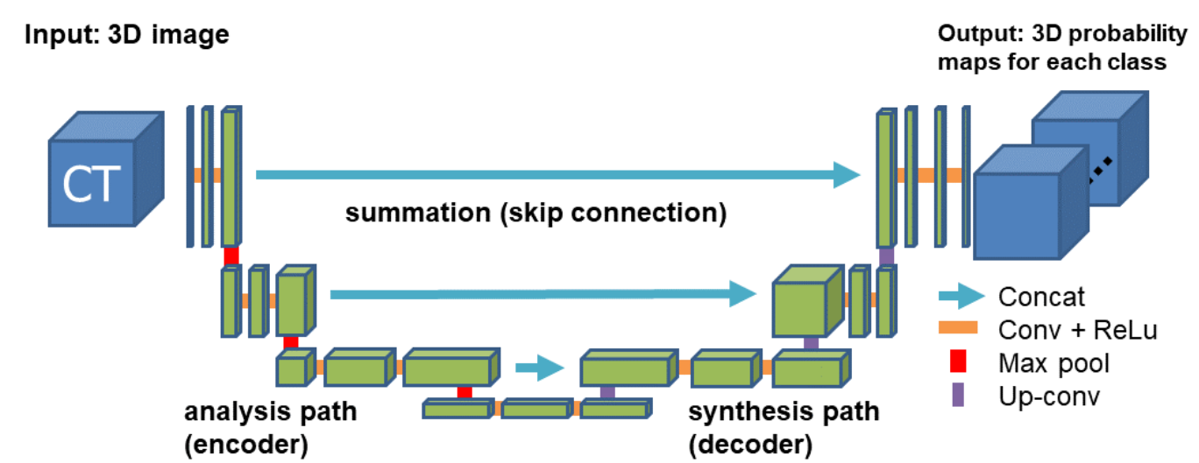
Common DNN Architectures for 3D segmentation – UNET 3D
3D-Unet has an analysis and a synthesis path each with four resolution steps
Shortcut connections from layers of equal resolution in the analysis path provide high-resolution features to the synthesis path.

Slide 17
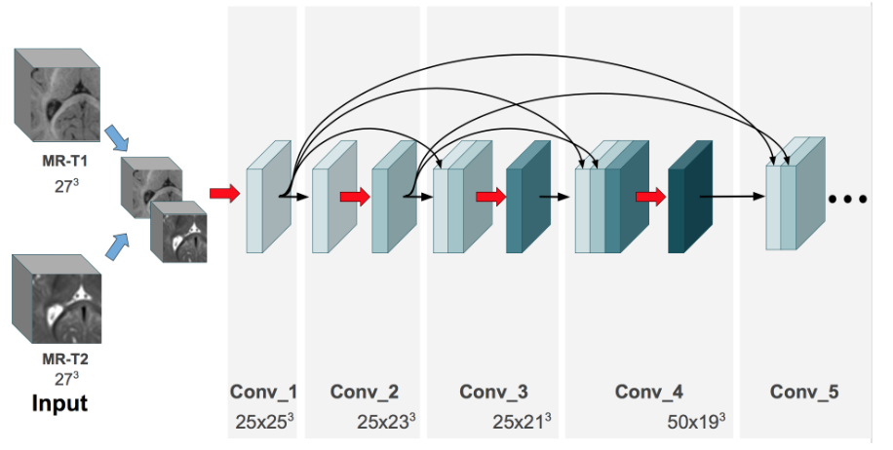
Common DNN Architectures for 3D segmentation – 3D DenseNet
DenseNets are built on the idea that adding direct connections from any layer to all the subsequent layers in a feed-forward manner makes training easier and more accurate
Direct connections between all layers help improving the flow of gradients

Slide 18
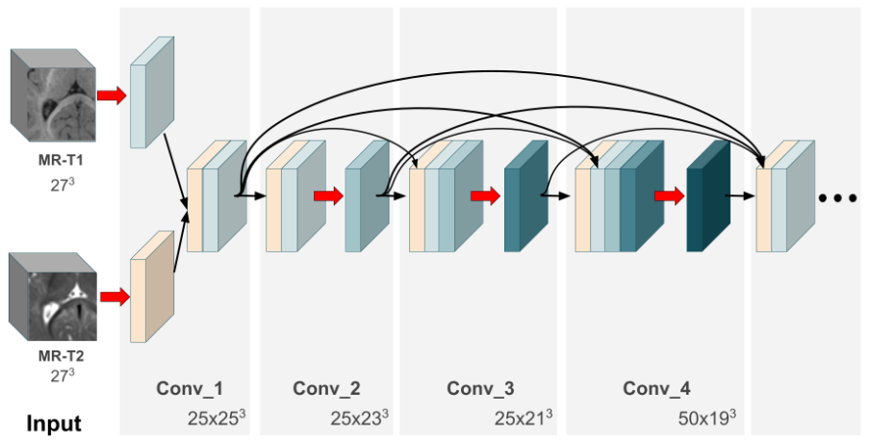
Common DNN Architectures for 3D segmentation – 2 stream 3D DenseNet
Instead of concatenating the abstract features of the last layers, we fuse simpler features of the first 3D convolutional networks

Slide 19
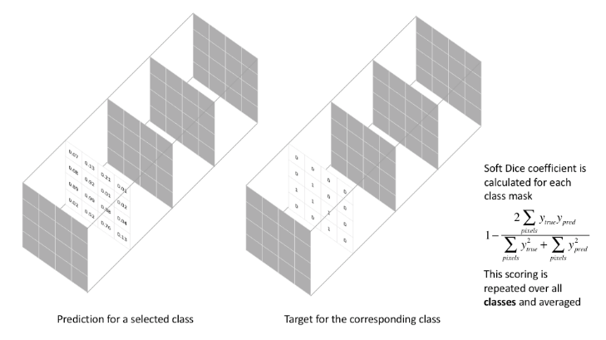
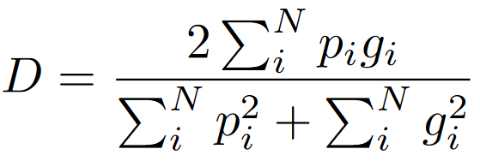
The Dice Loss function
Solves the problem of imbalanced segmentation datasets

Slide 20
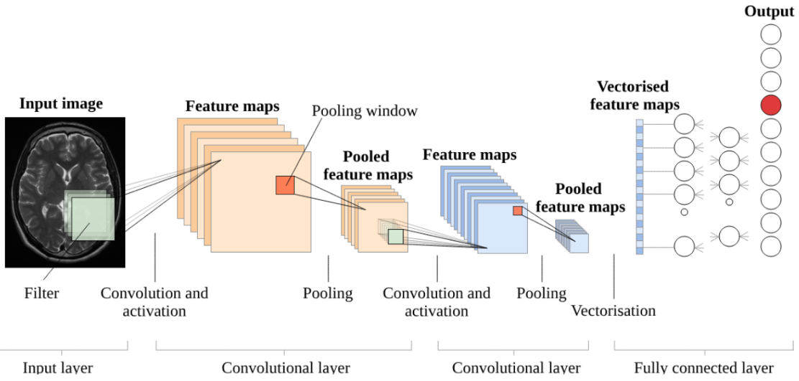
Putting it all together

Slide 21
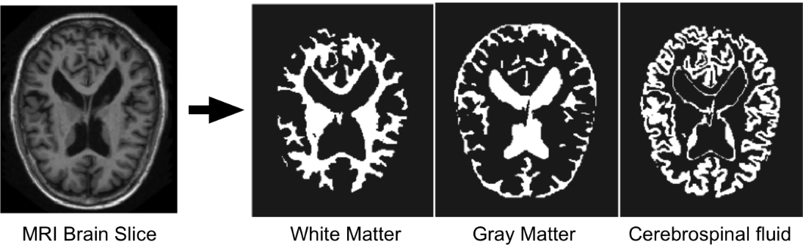
Brain Segmentation – 4 basic classes
White matter refers to areas that are mainly made up of myelinated axons
Grey matter consists of neuronal cell bodies & dendrites
Cerebrospinal fluid (CSF) colorless body fluid found in the brain that acts as a mechanical and immunological protection to the brain inside the skull

Slide 22
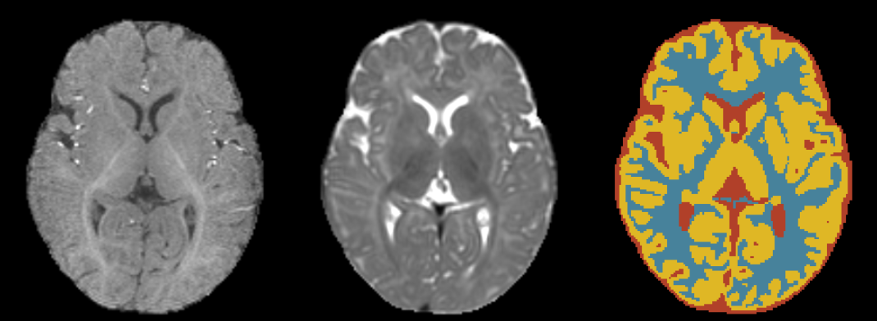
Multi-modal brain MRI Datasets: ISEG 2017
Segmentation algorithms on 6-month infant brain MRI (MICCAI 2017 challenge)
The dataset contains 10 densely annotated images from experts and 13 imaging for testing.
Test labels are not provided, and you can only see your score after uploading the results in the official website
For each subject there is T1 weighted and T2 weighted image.

Slide 23
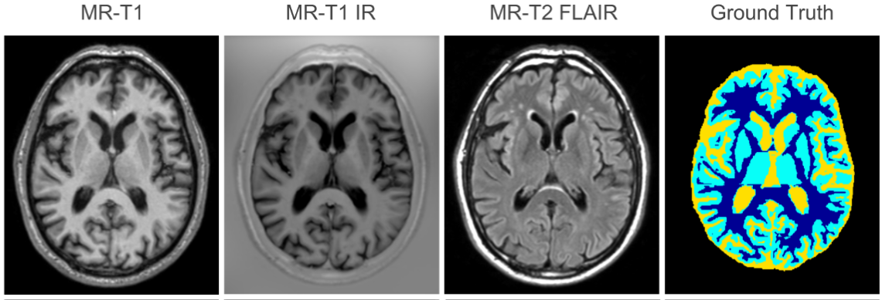
Multi-modal brain MRI Datasets: MRBRAINS 2018
8 annotated subject volumes
4 classes or 8 classes
Includes a few pathologies
For each subject there is T1-weighted, T1-weighted inversion recovery and T2-FLAIR are provided – 3 modalities

Slide 24
Experimental evaluation
Non empty sub-volumes of 128x128x64 and 28³
Uniform random sampling 500 and 2k samples
Mean/std normalization on non-zero voxels
Images are registered and bias field corrected
First subject was used as validation

Slide 25
Experimental evaluation – model summary
 | #Parameters (in millions) | # Layers | Volume size (ISEG/MrBrains) | Input Channels (MRI modalities) | GPU Training Memory (ISEG/MrBrains) in GB | Total train time in hours
Vnet | ~45M | 113 | 128x128x (64/32) | 1 | 4.1/3.9 GB | 6h
Vnet light | ~25M | 84 | 128x128x (64/32) | 1 | 2.5/2.0 GB | 5h
3D-Unet | ~10M | 95 | 128x128x (64/32) | 1, 2, 3 | 3.7/1.9 GB | 4h
3D-Densenet | ~2.7M | 34 | 28³ | 1, 2, 3 | 1.6 GB | 10h
2stream-3D-Densenet (late fusion) | ~5.2M | 67 | 28³ | 2 | 2 GB | 12h
2stream-3D-Densenet (early fusion) | ~2.9M | 40 | 28³ | 2 | 1.7 GB | 12h
3stream-3D-Densenet (early fusion) | ~3.4M | 43 | 28³ | 3 | 2.5 GB | 16h

Slide 26
Results on ISEG 2017, 2 modalities, 4 classes
 | Average DSC (%) | CSF (%) | GM (%) | WM (%)
Vnet | 87.20 | 92.53 | 71.42 | 84.88
Vnet light | 83.79 | 87.51 | 69.07 | 80.04
3D-Unet | 93.84 | 94.99 | 90.84 | 89.51
3D-Densenet | 75.51 | 79.40 | 74.90 | 63.92
2stream-3D-Densenet (late fusion) | 76.65 | 79.51 | 72.43 | 63.01
2stream-3D-Densenet (early fusion) | 78.63 | 86.23 | 75.72 | 70.71

Slide 27
Results on MR-Brains 2018, 3 modalities, 4 classes
 | Average DSC (%) | CSF (%) | GM (%) | WM (%)
Vnet | 83.04 | 79.88 | 83.04 | 77.34
Vnet light | 82.63 | 77.80 | 84.85 | 76.15
3D-Unet | 86.64 | 80.57 | 85.01 | 82.83
3D-Densenet | 65.11 | 59.96 | 49.93 | 67.02
2stream-3D-Densenet (late fusion) | 68.21 | 54.00 | 60.42 | 71.75
2stream-3D-Densenet (early fusion) | 70.02 | 64.07 | 61.01 | 71.97
3 stream 3D Densenet – early fusion | 76.89 | 72.06 | 69.43 | 80.08

Slide 28
Experimental results - Summary
DSC in % | I-Seg 2017 4 classes | MrBrains 2018 4 classes
Vnet | 87.20 | 83.04
Vnet light | 83.79 | 82.63
3D-Unet | 93.84 | 86.64
3D-Densenet | 75.51 | 65.11
2 stream-3D-Densenet (late fusion) | 76.65 | 68.21
2 stream-3D-Densenet (early fusion) | 78.63 | 70.02
3 stream 3D-Densenet (early fusion) | - | 76.89

Slide 29
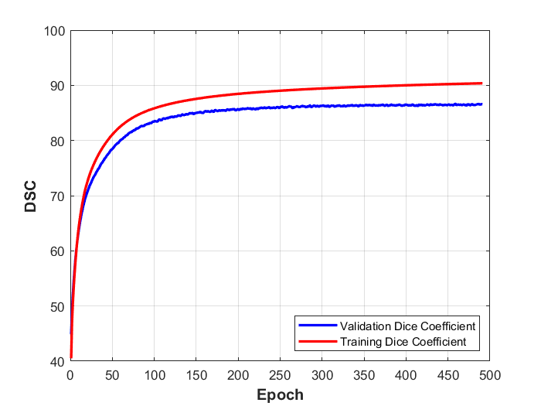
Average dice coefficient – Unet3D MrBrains 2018

Slide 30
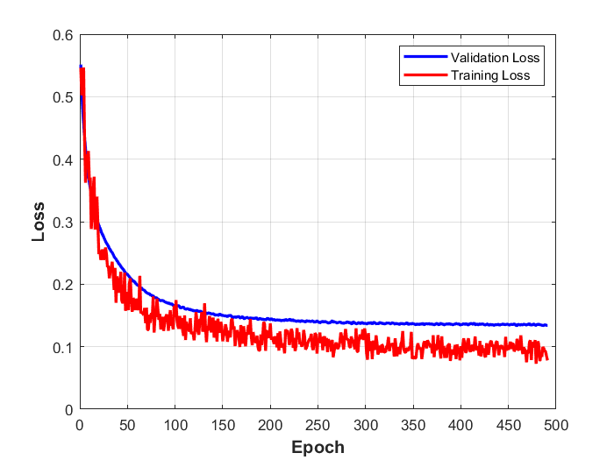
Average dice loss – Unet3D MrBrains 2018

Slide 31
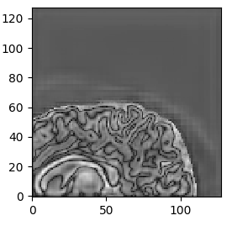
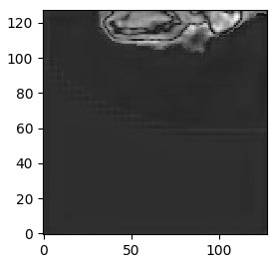
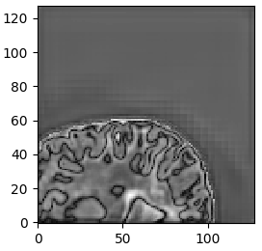
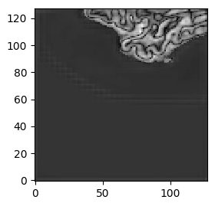
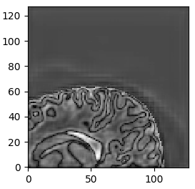
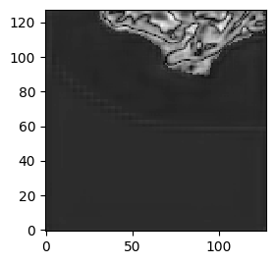
Visualization of output feature volumes
High semantic structures are learned
The network tries to somehow reconstruct the input brain structures to predict a good volumetric brain segmentation

Slide 32
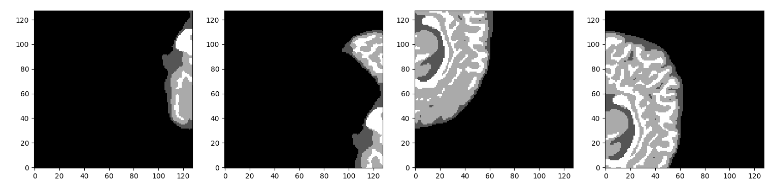
Visualizing predicted sub-volume predictions on validation set
the network predicts air voxels with excellent accuracy
predictions are not so good near the boundaries

Slide 33
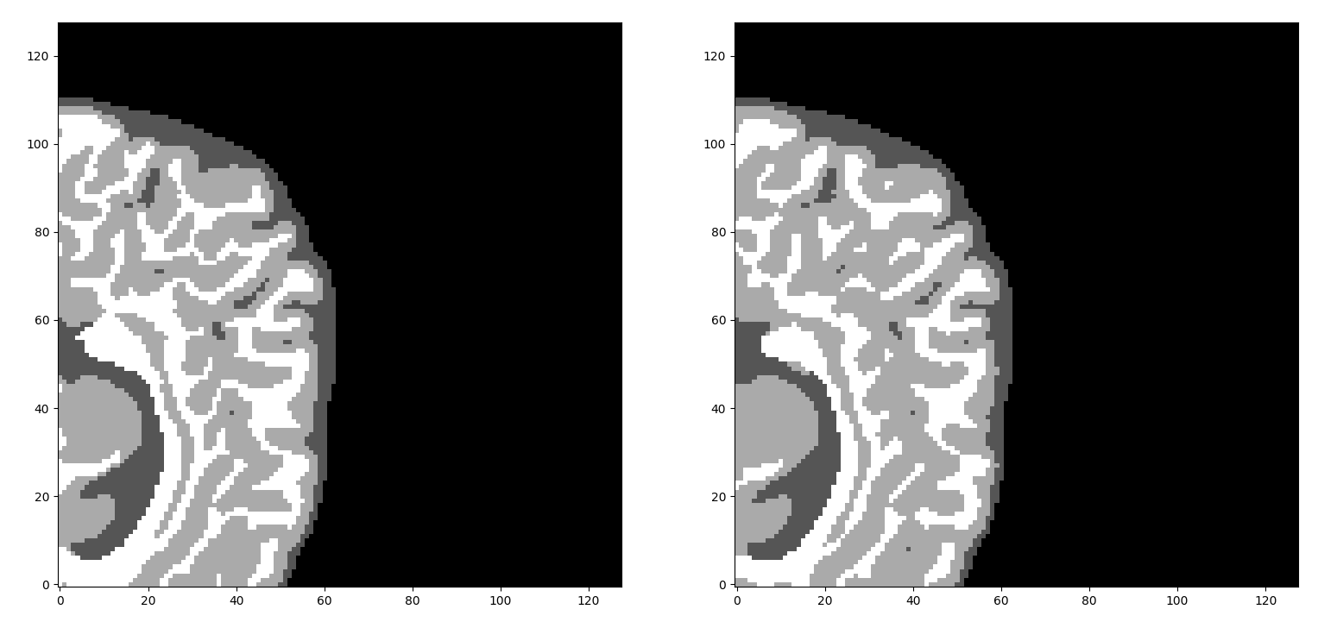
Comparison with ground truth segmentation 1/2

Slide 34
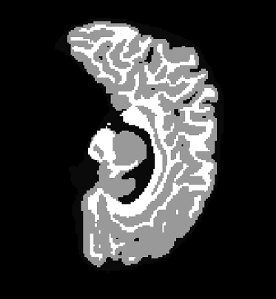
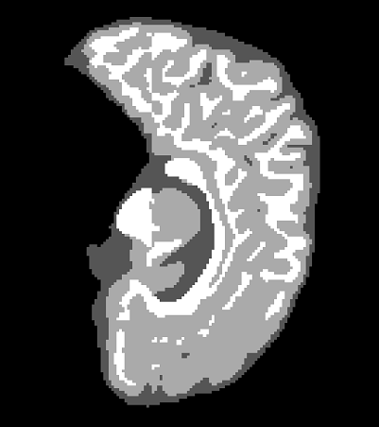
Full Slice segmentation G.T. VS Combined segmentation from 4 overlapping predictions

Slide 35
Medical Zoo PyTorch – alpha release
Collection of 3D deep architectures for medical image segmentation
Data loaders for all publicly available medical datasets
Pretrained models
https://github.com/black0017/MedicalZooPytorch

